Slide 1
Lifelong Guidance in Finland
Anna Toni (Ministry of Economic Affairs and Employment) & Ulla-Jill Karlsson (Ministry of Education and Culture)
23.5.2024 NICDS Seminar South Africa

Slide 2
Suomi Finland
1917 Finland’s independence
1948 Member of the World Bank
1948 Member of the IMF
1955 Member of the UN
1955 Member of the Nordic Council
1961 Associate member of the EFTA
1969 Member of the OECD
1986 Full EFTA membership
1989 Member of the Council of Europe
1995 Member of the European Union
2002 Introduction of the euro
2023 Full NATO membership

Slide 3
Finland
population 5.6 million (18 inhabitants / sq.k)
two official languages:
Finnish (85,9 %)
Swedish 5,2%)
persons with other languages (8.9 %)
education level of the working age population:
10 % basic education
46 % upper secondary education
42 % tertiary education

Slide 4
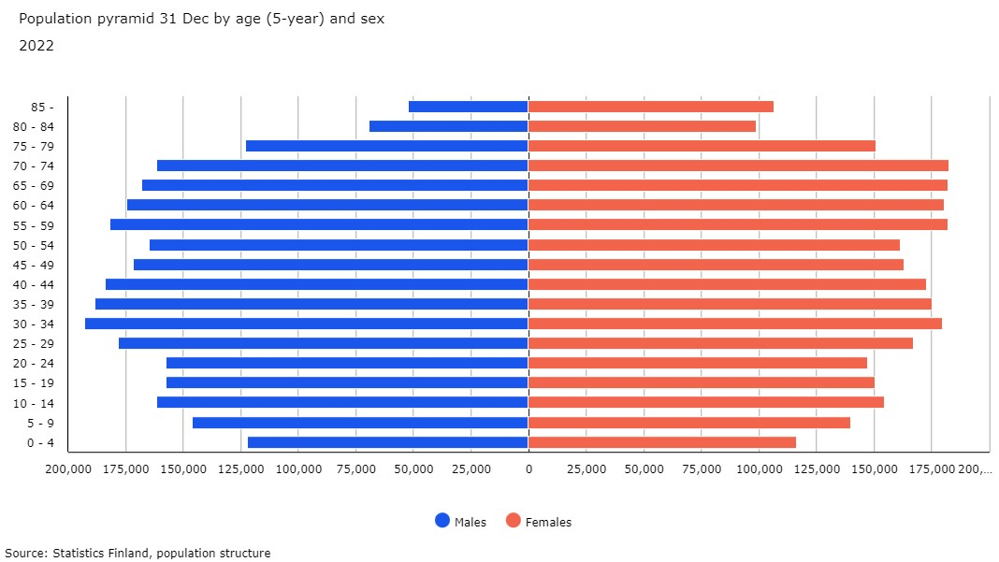
Finland – population pyramid 2022

Slide 5
Governance of Guidance

Slide 6
Case Finland:
Guidance services in different sectors all coordinated by the national lifelong guidance working group
Career counselling within education sector
Skills development and career guidance in PES
Information and advice services in municipalities
One-stop-guidance centers for youth (Ohjaamo) and other cross-sectoral services
Field specific guidance in Trade unions
Third sector
Private companies
Coaching, training, digital tools, own personnel

Slide 7
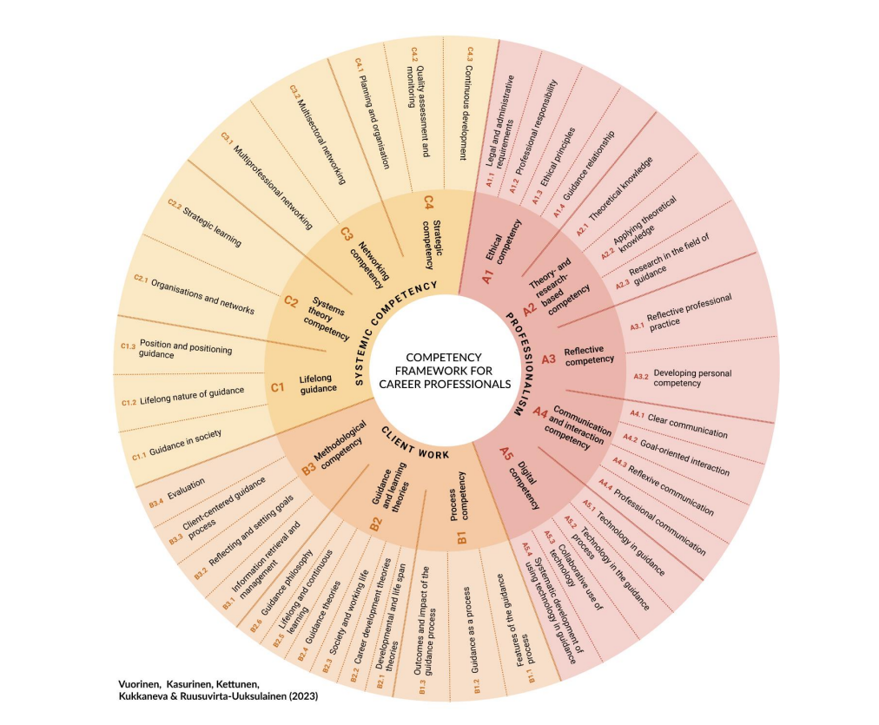
The guidance profession is highly appreciated and partly regulated

Slide 8
National strategic leadership & cooperation in Finland
Finland has a long tradition in career guidance both in employment and education sectors
National Lifelong Guidance Working Group (ELO-Forum) and a preparatory secretariat
Co-chaired by the Ministry of Education and Culture & Ministry of Employment and Economic Affairs
Representatives of Ministries of Finance, Social & Health, educational institutions, regional & local PES, universities, social partners, third sector and students
Strategic annual national targets, meetings, news letters, publications
Targets for regional working groups
Monitoring of national outcomes

Slide 9
Regional lifelong guidance cooperation groups
The implementation and development tasks of the central government are delegated to 15 Regional Centres for Economic Development, Transport and the Environment (ELY-centres)
Each ELY-centre is obliged to establish a regional lifelong guidance working group with representatives from educational institutions, PES, regional administration, social partners, municipalities, one-stop-guidance centers etc.
+3 Swedish-speaking co-operation groups
Operations: meetings and seminars, information exchange, study visits, training for guidance practitioners, project planning (for example EU-funded)
Example: to enhance and support the operating model of One-stop-guidance centers (Ohjaamo Centers)
Annual strategic targets
Regular unformal meetings with the chairs of the regional working groups and ministries

Slide 10
National Lifelong Guidance Strategy

Slide 11
Finland follows global regulation and recommendation on Lifelong Guidance
Finland takes active part in international guidance networks and events
ICCDPP
European Commission, Cedefop, ETF
ILO
OECD
Unesco
IAEVG
Nordic co-operation
Recent reports:
COM: Lifelong guidance policy and practice in the EU - trends, challenges and learning environments (2019)
COM, ETF, Cedefop, OECD, ILO, Unesco: Investing In Career Guidance (2021) ja Investing in Career Guidance – case for workers (2023) IAG_2023-06-26.pdf (europa.eu)
IAEVG next international conference on career guidance 2024 to be held in Jyväskylä, Finland (12.-14.11.2024): https://peda.net/iaevgconference2024

Slide 12
Nordic Council of Ministers
The Nordic Council of Ministers and the Nordic Council are the main forums for official Nordic co-operation
involves Denmark, Finland, Iceland, Norway, Sweden, the Faroe Islands, Greenland and Åland.
The Nordic network for adult learning (NVL) supports Nordic cooperation in policy development and implementation regarding lifelong learning and competence development.
NVL is a collaborative platform for adult education providers and policy makers.
One of the Networks: Nordic network for guidance, since 2009
contributes to the knowledge exchange and development of guidance in the Nordic countries
improves the coordination of guidance between education and labor administration in the Nordics
supports individuals' transition between education and working life and contributes to mobility in the Nordics.
Publications: A Nordic perspective on green career guidance A Nordic perspective on green career guidance - NVL

Slide 13
ICCDPP (INTERNATIONAL CENTRE FOR CAREER DEVELOPMENT AND PUBLIC POLICY) recommendations (2019)
Changed operating environment
Career guidance needs a cross-administrative strategy and must be reconciled with the policies of competence development, education, employment and social policy
Policy-making and development work require a quantitative and qualitative knowledge base
Mechanisms for sharing well-functioning practices internationally
Career guidance measures must support citizens' own career planning skills
Better availability
Improve awareness of career guidance support and services and their availability throughout life
Identify the needs of different target groups and take them into account when planning programmes and services
Career planning in society
Develop ways of cooperation in national administrative and development work
Involving citizens in the development of measures and services
National actor in coordinating and consulting lifelong guidance
Supporting innovations
Resources for generating and piloting new innovations in career guidance services
Multi-channel service provision in which digital services are integrated into other services
Career guidance professionals must be trained and able to renew and develop their activities

Slide 14
European Commission - Lifelong guidance policy and practice in the EU trends, challenges and learning environments (2019)
Eleven key features of LLG systems in the EU provided the framework for this study. These included:
1. Lifelong guidance legislation – the legislation and organisational rules that control provision of services, qualifications and national accountability of services;
2. Strategic leadership – the EU and national policy and systems that guide the development, management and delivery of LLG systems and services;
3. Scope of provision in diverse guidance contexts – where guidance provision is situated and how it is organised within and across diverse guidance contexts;
4. Lifelong guidance and lifelong learning strategies and policies – the existence, inter-connectedness and/or relationship between the policies to define the role LLG plays in lifelong learning;
5. Coordination and cooperation – the agents involved in the Organisation and delivery of LLG systems and how they are coordinated;
6. Living of guidance – the types of modes in place that define how services are provided;
7. Labour market information – the Labour market data that are collected and dissemination within a LLG system;
8. ICT strategy – the approach to how ICT will be developed and integrated in to LLG systems;
9. ICT operationalisation – how technology is used and for what reason in a LLG system;
10. Professionalisation – the qualifications, knowledge, skills and ethical standards required by Those delivery LLG services;
11. Evidence of impact of Lifelong Guidance – the methods by which services and the outcomes are measured and evidenced to influence the development of LLG systems.

Slide 15
Guidance for Lifelong learning (Skills week seminar during Finnish EU Council Presidency 2019): How should guidance be developed in EU?
Comprehensive career guidance – more cooperation between the employment, education and social sectors
Change of perspective in career guidance from offering services to supporting individuals' career planning
Lifelong guidance requires an action plan at EU/national level that is linked to larger programs, such as the implementation of the European Social Pillar at EU level
A clear EU/national actor to be responsible for developing career guidance
Definition of common principles and recommendations and EU/national indicators for career guidance and targeted funding
Better definition of career planning skills (career management skills) and career guidance at the workplace

Slide 16
Guidance for Lifelong learning (Skills week seminar during Finnish EU Council Presidency 2019)

Slide 17
OECD: system of continuous learning, Finland's challenges (2019)
Finland does not have a comprehensive strategy for continuous learning
Shortcomings/gaps in education provision
The system encourages participation in education leading to a qualification (free of charge, openness, benefits)
The current provision of education does not meet the needs of working life very well – partly because the mechanisms for utilising foresight data are weak
OECD countries' largest differences in participation between those with a lower level of education and those with a medium/high level of skills. Targeted support is limited.
According to the OECD, Finland should:
diversify its education and training provision;
make the education and training provided more labour market relevant;
incentivise individuals to engage in labour market relevant training;
provide comprehensive information and guidance services;
develop tailored education programmes; and
reach out to adults with low basic skills.

Slide 18
The strategy for lifelong guidance in Finland (2020) sets out national goals for guidance
Accessible and Customer-orientated
Digital
High-quality and Competent
Equal and Sustainable
Cross-sectoral and Coordinated
Evidence-based
Everyone has the potential and skills to make well-informed and conscious plans and decisions on their upskilling and careers in a changing world of work.
A well-functioning ecosystem of digital services for continuous learning, in which guidance and career development are at the centre, serving lifelong learners smoothly, including the use of artificial intelligence.
Guidance professionals have the capabilities and competence to perform high-quality, multi-channelled guidance work.
Guidance promotes an equal, fair and diverse society in Finland.
Sectors responsible for guidance co-operate smoothly with clear division of labour. Measures to develop guidance that are prepared in different sectors will be jointly planned and implemented through multi-administrative cooperation between different administrative branches.
The long-term objective is an evidence-based lifelong guidance system and policy development. Enhancing evidence-base by national and regional cross-sectoral monitoring and impact assessment of guidance services. Individuals have digital data on their skills and careers.

Slide 19
Update of the National Lifelong Guidance Strategy 2023: discussion provoking questions for stakeholders on all levels
Who are our key customers, what are their needs, and how could guidance be developed based on these needs?
How could we support individuals’ career management skills better? How could career planning at workplaces be enforced?
What kind of digitals toos and systems support our guidance work and how could their use be supported and promoted?
How could we ensure guidance professionals’ skills recognition and re- and upskilling?
How can we ensure that guidance is responsible, ethical and takes special needs into consideration?
How can we include the following themes in the guidance: gender segregation of professions, stereotypes, internationalization and multiculturalism and sustainability/fair transition?
How could co-operation between colleagues, organisations and regional stakeholders be developed further? How is multisectoral and multiprofessional work supported?
How is the quality, availability, results and impacts of guidance measured and monitored, and how is guidance being developed based on this information?

Slide 20
Sustainable Growth Programme for Finland: https://julkaisut.valtioneuvosto.fi/handle/10024/163363 (eng) Pillar 3: Raising the employment rate and upskilling to accelerate sustainable growth Upskilling and continuous learning reform Reform of continuous learning
EU Funding
Finance of training programmes and outreaching activities 30 M€ (SECLE)
Developing a forecasting system for labour and competence needs 4 M€ (MEAE, SECLE, OPH)
Developing lifelong guidance and identification of skills 10 M€ (MEAE, SECLE)
Developing identification of non-formal and informal learning of working-age people (MEAE 3 M€)
Skills mapping (SECLE 3 M€)
Fostering lifelong guidance (MEAE 4 M€)
Developing coordination and evidence-base of lifelong guidance
Developing national framework for career management skills
Developing guidance competencies: competence framework, training for professionals etc.
Digitalisation programme for continuous learning
Digitalisation of continuous learning 32 M€ (MEC, MEAE)
Digital service for continuous learning (/career planning) 22 M€ (MEC & MEAE)
Digivision for higher education 10 M€ (MEC)
Employment and labour market
New customer service model in PES (Nordic model) 90 M€
Enhancing multiprofessional services for young people 6,5 M€

Slide 21
Multisectoral guidance services

Slide 22
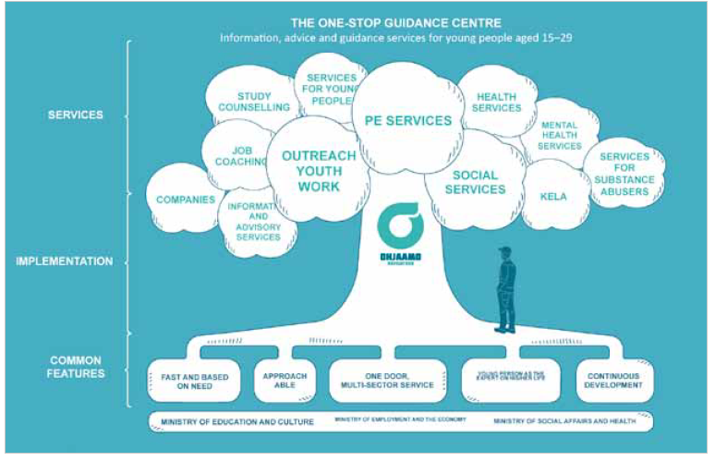
Example 1: the one-stop-guidance centers for youth (Ohjaamo in Finnish)
The voice of youth is heard
Ministry of Education and Culture – Ministry of Economic Affairs and Employement – Ministry of Social Affairs and Health
EU Youth Guarantee

Slide 23
Ohjaamo one-stop-shops in a nutshell
65 service points; cover majority of the youth population in Finland
Over 850 employees from different organizations working at least one day per week
”Onni”-project to strengthen psychosocial support
RRF-project to support multidisciplinary character – resources to hire experts from social-, healthcare- or education sector
Finnish ”solution” to EU youth guarantee; still things to be done.. (NEET-rate 15-29y 2015 11,9% -> 2018 9,6% -> 2022 9,2%)

Slide 24
Integrated Services: The Take-Away
Customer-oriented public services: let the public servants run together the needed services - the customer shouldn’t have to run from door to door
Integrated services receive good and excellent feedback from the customers
Integration doesn’t happen overnight: needs planning, commitment, leadership, coordination, data and monitoring systems, training of the staff…
Enthusiasm and motivation of the staff is essential; resilience to survive between pressures of two (or more) organisations
In the future we need to understand
how many ”one-stop-shops” for different target groups we can have
the role of digital services to support integrated services -> digital services need integration as well
How to encourage local integrated service models and still gather information and facilitate support nationally

Slide 25
Thank you!

